Slide 1
SWE2210 Software Construction
Lecture 01
Venue: Lab 3
Time: 11 – 1:00pm

Slide 2
Content of previous Lecture
Introduction.
What is software construction.
Construction and non-construction activities
Why is software construction importance?
Metaphors for software construction.
Software construction approaches.

Slide 3
Creating High-Quality Code

Slide 4
Contents
Is Design Part of Construction
The Different Levels of Design
Characteristics of High Quality Design
The Main Steps in OOP Design
Some Principles of Good Design

Slide 5
Is Design Part of Construction
Some people might argue that design isn’t really a construction activity, but on small projects, many activities are thought of as construction, often including design.
On some larger projects, a formal architecture might address only the system-level issues and much design work might intentionally be left for construction. On large projects, the design might be intended to be detailed enough for coding to be fairly mechanical.

Slide 6
Is Design Part of Construction?
On small, informal projects, a lot of design is done while the programmer sits at the keyboard. “Design” might be just writing a class interface in pseudocode before writing the details.
It might be drawing diagrams of a few class relationships before coding them. It might be asking another programmer which design pattern seems like a better choice.
Regardless of how it’s done, small projects benefit from careful design just as larger projects do, and recognizing design as an explicit activity maximizes the benefit you will receive from it.

Slide 7
The Different Levels of Design

Slide 8
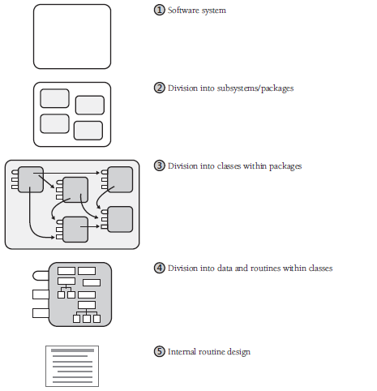
The Different Levels of Design

Slide 9
Design at Different Levels
Level 1: Software System
The first level is the entire system consisting of all its components including the user interface, the various processing components, the database system etc. Design at this level entails clearly understanding what the entire system is expected to do
Level 2: Division into Subsystems or Packages. The major design activity at this level is deciding how to partition the program into major subsystems and defining how each subsystem is allowed to use each other subsystem.

Slide 10
Design at Different Levels
Level 3: Division into Classes
Design at this level includes identifying all classes in the system. Details of the ways in which each class interacts with the rest of the system are also specified as the classes are specified. In particular, the class’s interface is defined.
Overall, the major design activity at this level is making sure that all the subsystems have been decomposed to a level of detail fine enough that you can implement their parts as individual classes.

Slide 11
Design at Different Levels
Level 4: Division into Routines
Design at this level includes dividing each class into routines. The class interface defined at Level 3 will define some of the routines. Design at Level 4 will detail the class’s private routines.
When you examine the details of the routines inside a class, you can see that many routines are simple boxes but a few are composed of hierarchically organized routines, which require still more design.

Slide 12
Design at Different Levels
Level 5: Internal Routine Design
Design at the routine level consists of laying out the detailed functionality of the individual routines. Internal routine design is typically left to the programmers who are working on an individual routine.
The design consists of activities such as writing pseudocode, looking up algorithms in reference books, deciding how to organize the paragraphs of code in a routine, and writing programming-language code.
This level of design is always done, though sometimes it’s done unconsciously and poorly rather than consciously and well

Slide 13
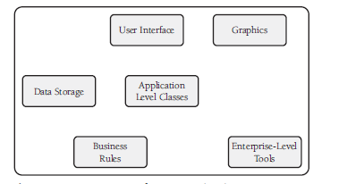
An Example of a System With 6 Sub-systems

Slide 14
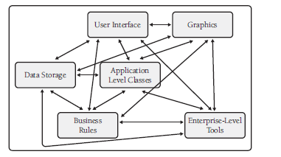
No Restrictions on Inter Subsystems Communications

Slide 15
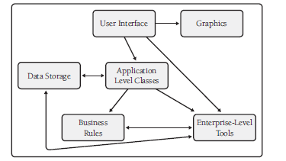
The Ideal Situation is to have communications between only a few subsystems.

Slide 16
Characteristics of a High Quality Design

Slide 17
Characteristics of a High Quality Design
Minimal complexity: The primary goal of design should be to minimize complexity. A good design should be easily understand. Avoid making “clever” designs. Clever designs are usually hard to understand. Instead make it “simple” and “easy-to-understand” designs. Unless a design solution is easily understandable, it would be difficult to implement and maintain.
Ease of maintenance: A good design should be easy to change. This is an important characteristic, since change requests usually keep coming from the customer even after product release. Think of the maintenance programmer as your audience, and then design the system to be self-explanatory.
Loose coupling: Loose coupling means designing so that you hold connections among different parts of a program to a minimum. Use the principles of good abstractions in class interfaces, encapsulation, and information hiding to design classes with as few interconnections as possible.

Slide 18
Characteristics of a High Quality Design
Extensibility: This means that you can enhance a system without causing violence to the underlying structure. You can change a piece of a system without affecting other pieces. The most likely changes cause the system the least trauma.
Reusability: This means designing the system so that you can reuse pieces of it in other systems.
High fan-in: This refers to having a high number of classes that use a given class. High fan-in implies that a system has been designed to make good use of utility classes at the lower levels in the system.

Slide 19
Characteristics of a High Quality Design
Portability: This means designing the system so that you can easily move it to another environment.
Leanness: This means designing the system so that it has no unnecessary extra parts

Slide 20
Difference between Object-Oriented and Non-Object Oriented Programming Languages:
The Object-Oriented languages have powerful features to develop real-world scenario applications whereas Non-Object Oriented languages such as Procedural languages have limited features to relate with real-time applications.
Object-Oriented Programming follows the bottom-up approach whereas Non-Object Oriented Programming model follows a top-down approach.
Programming features will be divided into methods or objects whereas Non-Object Oriented Programming defines functions as the piece of code to perform operations.

Slide 21
Difference between Object-Oriented and Non-Object Oriented Programming Languages:
Data hiding can be done in Object-Oriented Programming whereas Data hiding is not possible in Non-Object Oriented Programming.
Inheritance and Abstraction are the powerful features present in Object-Oriented Programming whereas these do not exist in Non-Object Oriented Programming.
Operator Overloading is allowed in Object-Oriented Programming whereas it is not allowed in Non-Object Oriented Programming.
The examples of Non-Object Oriented Programming are Pascal, FORTRAN etc.

Slide 22
The Main Steps in OOP Design

Slide 23
The Main Steps in OOP Design
■ Identify the objects and their attributes (methods and data).
■ Determine what can be done to each object.
■ Determine what each object is allowed to do to other objects.
■ Determine the parts of each object that will be visible to other objects—which parts will be public and which will be private.
■ Define each object’s public interface.

Slide 24
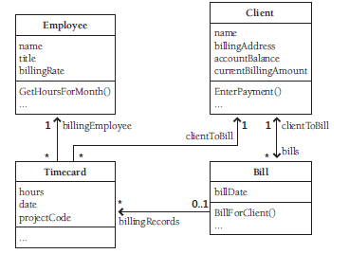
Identifying the Objects and Their Attributes
Identify the objects and their attributes Computer programs are usually based on real-world entities. For example, you could base a time-billing system on real-world employees, clients, timecards, and bills as shown in the figure on the right side.

Slide 25
Identifying the Objects and Their Attributes
Each object has characteristics that are relevant to the computer program.
For example, in the time-billing system, an employee object has a name, a title, and a billing rate. A client object has a name, a billing address, and an account balance. A bill object has a billing amount, a client name, a billing date, and so on.

Slide 26
Determine what can be done to each object
A variety of operations can be performed on each object. In the billing system shown earlier, an employee object could have a change in title or billing rate, a client object could have its name or billing address changed, and so on.

Slide 27
Determine what each object is allowed to do to other objects
In our diagram, a timecard object can contain an employee object and a client object, and a bill can contain one or more timecards.
In addition, a bill can indicate that a client has been billed, and a client can enter payments against a bill.

Slide 28
Determine the parts of each object that will be visible to other objects
One of the key design decisions is identifying the parts of an object that should be made public and those that should be kept private. This decision has to be made for both data and methods.
Define each object’s interfaces Define the formal, syntactic, programming-language level interfaces to each object. The data and methods the object exposes to every other object is called the object’s “public interface.” The parts of the object that it exposes to derived objects via inheritance is called the object’s “protected interface.” Think about both kinds of interfaces.

Slide 29
Some Principles of Good Design

Slide 30
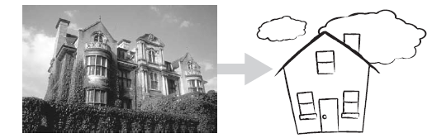
Abstractions allow you to take a simpler view of a complex concept
Abstraction is the ability to engage with a concept while safely ignoring some of its details—handling different details at different levels.
If you refer to an object as a “house” rather than a combination of glass, wood, and nails, you’re making an abstraction. If you refer to a collection of houses as a “town,” you’re making another abstraction.

Slide 31
Abstraction
Abstraction is the act of hidden the internal details of a class from the outer classes. Abstraction is used to describe component or thing is a simple terms.

Slide 32

Encapsulation
Encapsulation picks up where abstraction leaves off. Abstraction says, “You’re allowed to look at an object at a high level of detail.” Encapsulation says, “Furthermore, you aren’t allowed to look at an object at any other level of detail.”

Slide 33
Encapsulation
Encapsulation refers to the bundling of data with methods that operate on that data. It hide the value or state of a structured data object inside a class preventing unauthorized parties direct access them
To access the values usually is through using setters and getters methods

Slide 34
Inheritance
In designing a software system, you’ll often find objects that are much like other objects, except for a few differences. In an accounting system, for instance, you might have both full-time and part-time employees. Most of the data associated with both kinds of employees is the same, but some is different.
In object-oriented programming, you can define a general type of employee and then define full-time employees as general employees, except for a few differences, and part-time employees also as general employees, except for a few differences.

Slide 35
Inheritance
When an operation on an employee doesn’t depend on the type of employee, the operation is handled as if the employee were just a general employee. When the operation depends on whether the employee is full-time or part-time, the operation is handled differently.
The benefit of inheritance is that it works synergistically with the notion of abstraction.
Inheritance simplifies programming because you write a general routine to handle anything that depends on a door’s general properties and then write specific routines to handle specific operations on specific kinds of doors. Some operations, such as

Slide 36
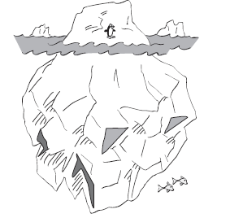
Information Hiding
Information hiding is part of the foundation of both structured design and object-oriented design. In structured design, the notion of “black boxes” comes from information hiding. In object-oriented design, it gives rise to the concepts of encapsulation and modularity and it is associated with the concept of abstraction. Information hiding is one of the seminal ideas in software development, and so this subsection explores it in depth.

Slide 37
Two Categories of Secrets
Secrets in information hiding fall into two general camps:
■ Hiding complexity so that your brain doesn’t have to deal with it unless you’re specifically concerned with it
■ Hiding sources of change so that when change occurs, the effects are localized

Slide 38
Keep Coupling Loose
Coupling describes how tightly a class or routine is related to other classes or routines. The goal is to create classes and routines with small, direct, visible, and flexible relations to other classes and routines, which is known as “loose coupling.”
Good coupling between modules is loose enough that one module can easily be used by other modules.
Try to create modules that depend little on other modules. Make them detached, as business associates are, rather than attached, as Siamese twins are.

Slide 39
Look For Common Design Patterns
Design patterns provide the cores of ready-made solutions that can be used to solve many of software’s most common problems.
Some software problems require solutions that are derived from first principles. But most problems are similar to past problems, and those can be solved using similar solutions, or patterns.

Slide 40
Other Principles
Iterate
Divide and Conquer
Top-Bottom vs Bottom Up Approaches
Experimental Prototyping
Collaborative Design
Capturing Your Design Work

